Slide 1

JavaScript Advanced
Course Introduction
SoftUni Team
Technical Trainers
Software University
https://softuni.bg
Notes:
<number>
© SoftUni – https://softuni.org. Copyrighted document. Unauthorized copy or reproduction is not permitted.

Slide 2
Table of Contents
Introduction
Course Objectives
Trainers and Team
Course Details
<number>
Notes:
<number>
© SoftUni – https://softuni.org. Copyrighted document. Unauthorized copy or reproduction is not permitted.

Slide 3
Have a Question?
sli.do
#js-advanced
<number>
Notes:
<number>
© SoftUni – https://softuni.org. Copyrighted document. Unauthorized copy or reproduction is not permitted.

Slide 4












SoftUni Diamond Partners

Slide 5


Educational Partners
<number>

Slide 6
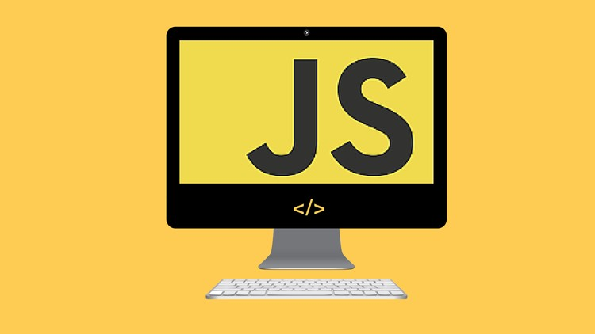
JS Advanced
Course Objectives
<number>

Slide 7
Course Objectives
Extends the JS Fundamentals course
Advanced coding skills for the JS language
Use contemporary techniques and paradigms
Master the DOM API and user interaction
Write code to solve realistic practical problems
<number>

Slide 8
JS Advanced – Course Topics
Syntax, Functions and Statements
Arrays & Matrices
Objects & Composition
DOM Introduction
DOM Events and Manipulation
<number>
Notes:
<number>
© SoftUni – https://softuni.org. Copyrighted document. Unauthorized copy or reproduction is not permitted.

Slide 9
JS Advanced – Course Topics
Advanced Functions
Unit Testing
Classes
Prototypes and Inheritance
Workshop
<number>

Slide 10

Trainers and Team

Slide 11
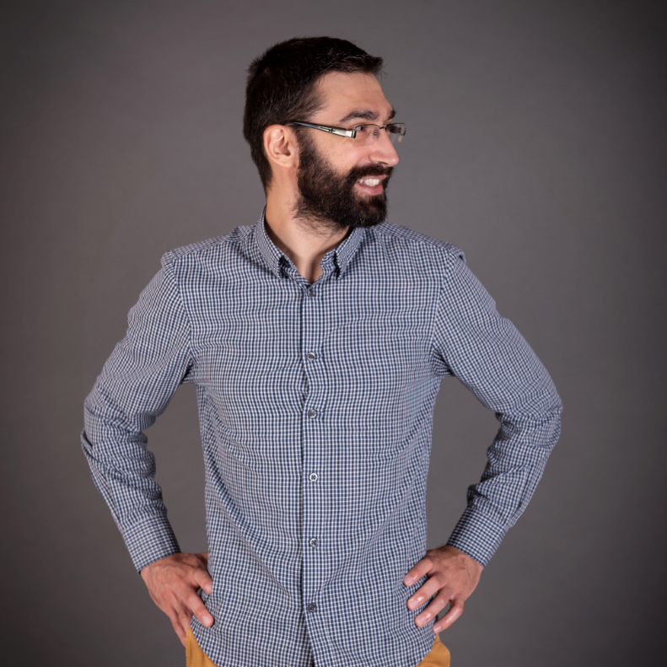
Viktor Kostadinov
Senior technical trainer with 5 years experience in the IT field
Head of the R&D Unit at Software University
Former Director of the Education Department
JavaScript enthusiast
<number>

Slide 12
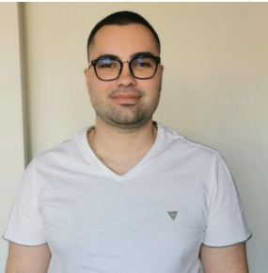
Stoyan Yanev
deep interests in process automation
Principle Engineer
Works with AWS architectures
AWS Certified Architect, AWS Certified Developer, AWS Certified SysOps
He has deep interests in process
automation
<number>

Slide 13

Course Details
Schedule

Slide 14

Practical Exam
Structure: 3 problems for 4 hours
Exam: 25 Jun 2022
Retake: 10 Aug 2022
Problems description:
Classes
DOM
Unit Testing
Link to Exams
<number>

Slide 15
Theoretical Exam
20 questions for 30 minutes
Multiple-choice
English
Automated quiz system
Available online
You can submit your answers just one time
<number>

Slide 16
JS Advanced Module Timeline
JS Advanced
Start: 17. May 2022
Exam: 25. Jun 2022
17.
25.
6 weeks
4 times per week
May
Jun
JS Applications
Start: 28. Jun 2022
Exam: 06. Aug 2022
28.
06.
6 weeks
4 times per week
Jun
July
Aug
Exam Retakes
JS Advanced: 10. Aug 2022
JS Applications: 15. Aug 2022
August
<number>
Notes:
<number>
© SoftUni – https://softuni.org. Copyrighted document. Unauthorized copy or reproduction is not permitted.

Slide 17
Course Scoring
Practice grade:
Theory grade:
SoftUni Certificate: 5.00 from Practice
CPE Certificate: 3.00 average from Practice + Theory
Practical Exam
Homework
100 %
+5 %
Theoretical Exam
100 %
<number>
<number>
Notes:
<number>
© SoftUni – https://softuni.org. Copyrighted document. Unauthorized copy or reproduction is not permitted.

Slide 18




Course Web Site, Forum and FB Group
Official web site:
Official discussion forum:
Official Facebook group:
Official SoftUni JavaScript Community:
https://softuni.bg/trainings/3707/js-advanced-may-2022
softuni.bg/forum/categories/19/
https://www.facebook.com/groups/JSAdvancedMay2022
facebook.com/groups/SoftUniJavaScriptCommunity/
<number>
Notes:
<number>
© SoftUni – https://softuni.org. Copyrighted document. Unauthorized copy or reproduction is not permitted.

Slide 19
Questions?
Notes:
<number>
© SoftUni – https://softuni.org. Copyrighted document. Unauthorized copy or reproduction is not permitted.

Slide 20
Trainings @ Software University (SoftUni)
Software University – High-Quality Education, Profession and Job for Software Developers
softuni.bg, softuni.org
Software University Foundation
softuni.foundation
Software University @ Facebook
facebook.com/SoftwareUniversity
Software University Forums
forum.softuni.bg
<number>
Notes:
<number>
© SoftUni – https://softuni.org. Copyrighted document. Unauthorized copy or reproduction is not permitted.

Slide 21

License
This course (slides, examples, demos, exercises, homework, documents, videos and other assets) is copyrighted content
Unauthorized copy, reproduction or use is illegal
© SoftUni – https://about.softuni.bg/
© Software University – https://softuni.bg
<number>
Notes:
<number>
© SoftUni – https://softuni.org. Copyrighted document. Unauthorized copy or reproduction is not permitted.

